Slide 1
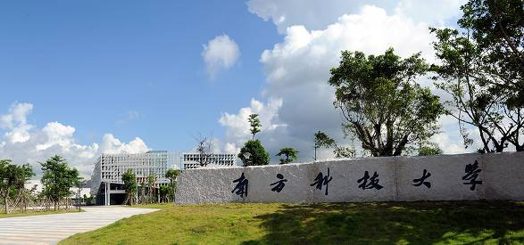
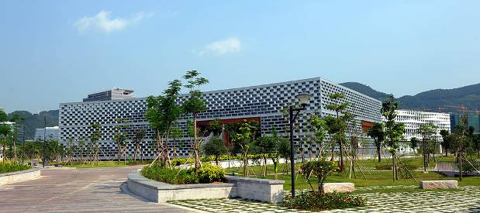
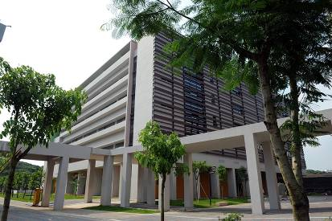
Engineering Electromagnetics 工程电磁场
Youwei Jia 嘉有为

Slide 2

Background
这是一门专业（微电子、通信、光电子）必修课 (Compulsory course), So you are suggested to work very hard on it.
Total Credits: 3 (Theory: 2, Experiment: 1)
Theory Courses: Tue 04:20-06:10 pm
Experiment Courses: Tue (Start from 5th week), 07:00pm-8:50 pm
Assessment of your Performance: Assignment: 15 % + Usual Performance 5 % Experiment Reports: 15 %
Final Examination: 65 %
1

Slide 3
Background
Part I: Vector Analysis矢量分析; Static Electric Field静电场; Steady Magnetic field稳恒磁场; Time-varying fields时变场 and Maxwell’s Equations麦克斯韦方程组
Instructor: Dr Youwei Jia
Period: 1st ~ 16th week
Future Course: 天线与电波传播
2

Slide 4
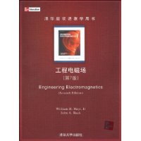
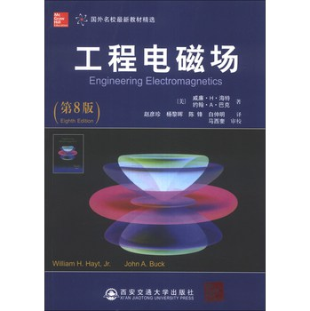
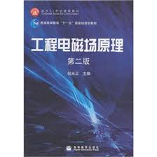
Background
References:
William H. Hayt and John A. Buck, 《Engineering Electromagnetics》
Mc Graw Hill, 清华大学出版社
William H. Hayt and John A. Buck, 赵彦珍等译, 《工程电磁场》
西安交通大学出版社
倪光正,《工程电磁场原理》, 高等教育出版社
3

Slide 5
Background
Some messages for you (Suggestions & expectations):
This course involves a lot of mathematics and physics, If you try to memorize them mechanically, it will be tough and boring. If you try to understand the natural essence 自然本质 behind the notations符号and equations公式, it will become more interesting.
My job is try my best to help you understand the most fundamental concepts概念, ideas想法, principles原理, laws规则 and theories理论. Based on that, you are expected to learn how to learn.
Keep thinking, keep practice. 勤思考，多练习
4

Slide 6

1: Vector Analysis 矢量分析
Scalar & Vector (Quantity) 标量&矢量
Scalar refers to a quantity whose value (值) could be represented by a real number (positive or negative).
Examples: Temperature 温度; Length 长度; Weight 重量
A vector quantity has both a magnitude (量、大小、模) and a direction (方向) in space (空间) .
Examples: Force 力; Speed 速度
Note:
1. Always give a second thought on the terms in red.
2. Most physical quantities (scalar or vector) have their own units (单位)；
3. Space has dimensions (维度，2-D, 3-D, …n-D);
5

Slide 7

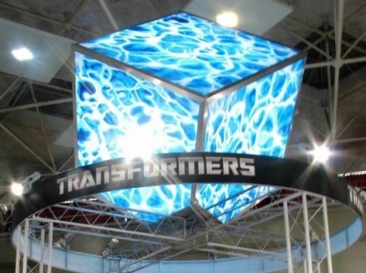

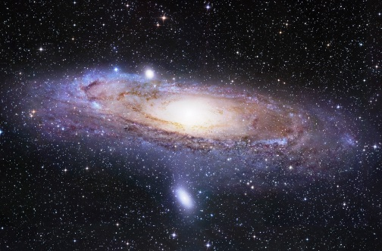
1: Vector Analysis 矢量分析
Field: Scalar Field & Vector Field 场、标量场、矢量场
Region, Space 区域、空间
Examples: a bowl of soup, energy cube, earth, universe….
When we associate some physical quantities (scalar or vector) with every point in some region/space, it involves a field (scalar or vector).
Note:
1. Mathematically, a field (scalar or vector) could be defined as some
function that connects an arbitrary origin to a general point in space.
6

Slide 8

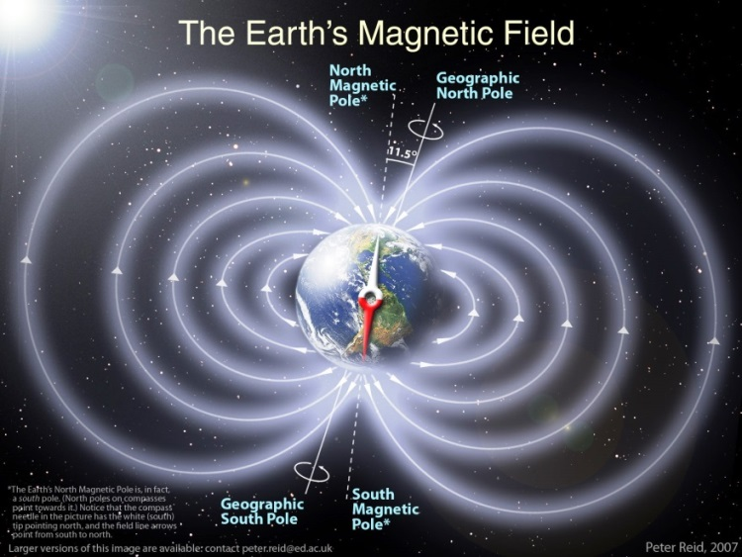
1: Vector Analysis 矢量分析
Field: Scalar Field & Vector Field 场、标量场、矢量场
Examples:
The temperature throughout the bowl of soup 温度场 (Scalar field)
Temperature—— Scalar quantity
The bowl of soup—— Region/Space
The magnetic field of the earth 地磁场(Vector field)
Magnetic field intensity (磁场强
度)—— Vector quantity
The earth—— Region/Space
7

Slide 9
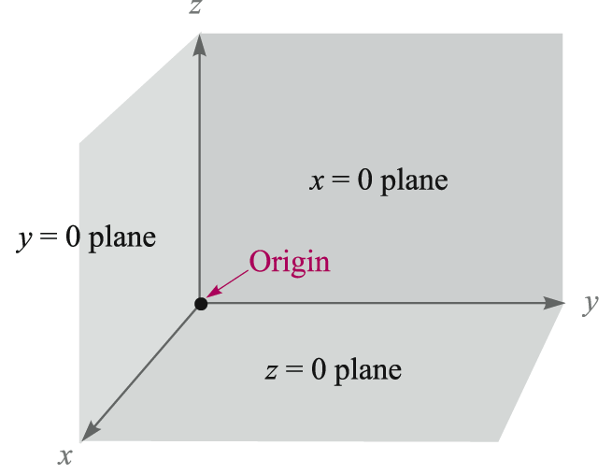
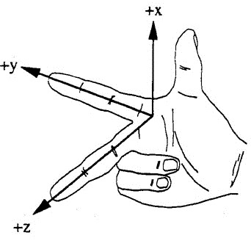
1: Vector Analysis 矢量分析
The Rectangular Coordinate System 直角坐标系
——A way we define spaces, vectors
Right-handed coordinate system
Origin原点: Point O
Axis轴: x-axis, y-axis, z-axis
8

Slide 10
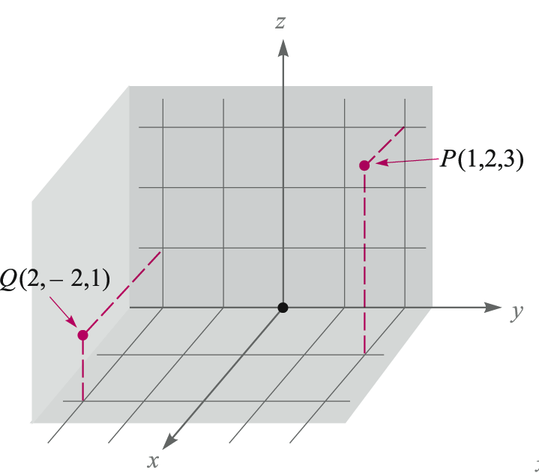
1: Vector Analysis 矢量分析
The Rectangular Coordinate System 直角坐标系
Point locations are defined by giving their coordinates(坐标).
Examples: P(1,2,3), Q(2,-2,1)
9

Slide 11
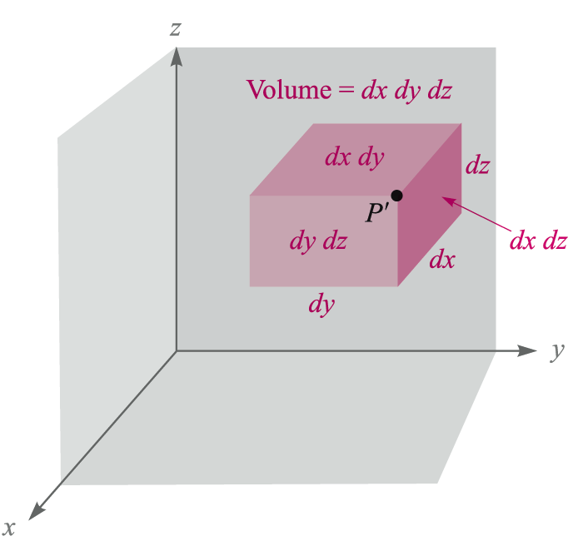
1: Vector Analysis 矢量分析
The Rectangular Coordinate System 直角坐标系
P(x, y, z)
P’(x+dx, y+dy, z+dz)
Differential Volume Element
体微元
dv=dxdydz
Differential Area Element
面微元
dS=dxdy, dxdz, dydz，
10

Slide 12
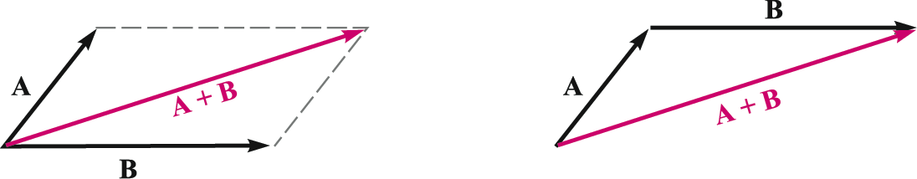
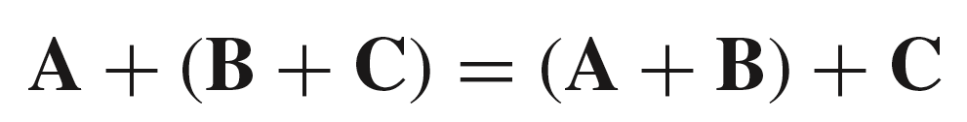
1: Vector Analysis 矢量分析
Vector Addition / Subtraction 矢量加法/减法
The addition of vectors follows the parallelogram law / triangle law 平行四边形法则/三角形法则
The rule for subtraction of vectors can be easily defined from that for addition: A-B=A+(-B)
Associative Law 结合律:
Distributive Law分配率:
11

Slide 13
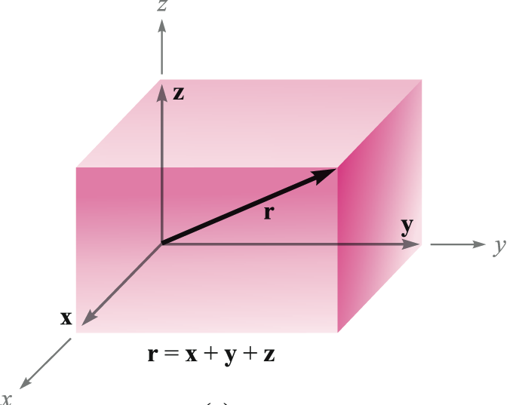
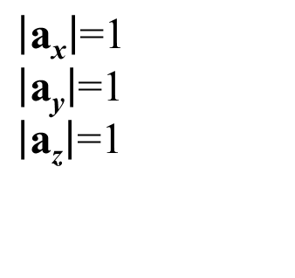
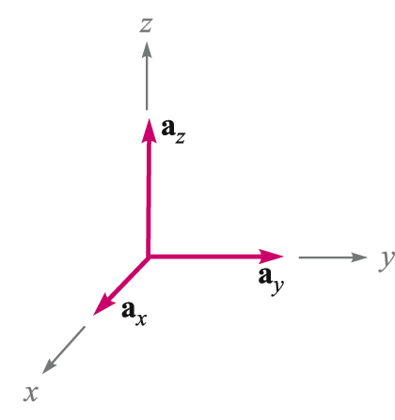

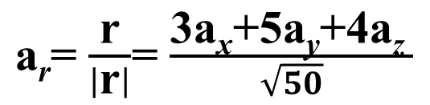
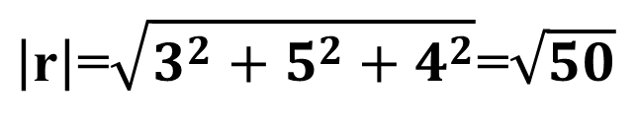
1: Vector Analysis 矢量分析
Vector Components & Unit Vectors矢量分量&单位矢量
P (3, 5, 4)
O (0, 0, 0)
Unit Vectors
r=3a_{x}+5a_{y}+4a_{z}
12

Slide 14
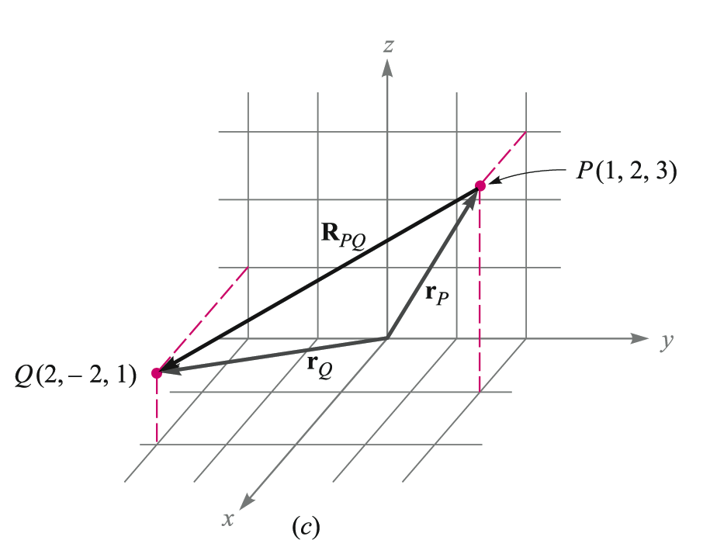
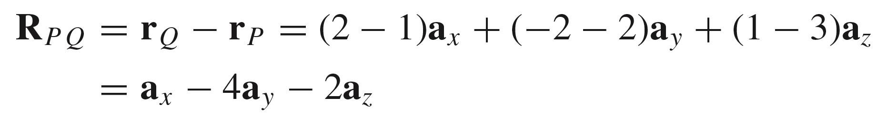
1: Vector Analysis 矢量分析
Vector Components & Unit Vectors矢量分量&单位矢量
13

Slide 15
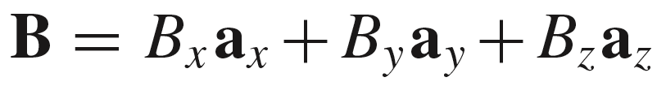
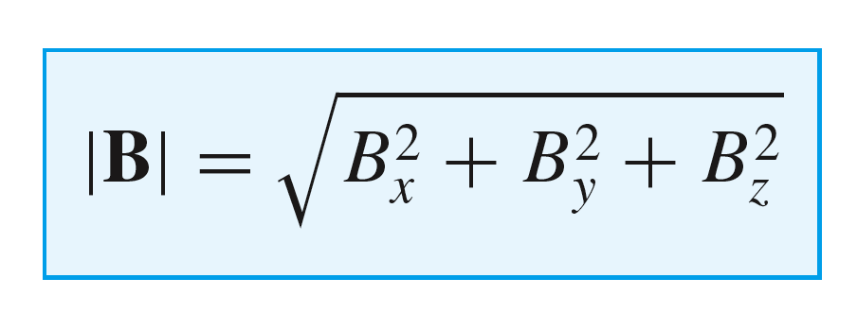
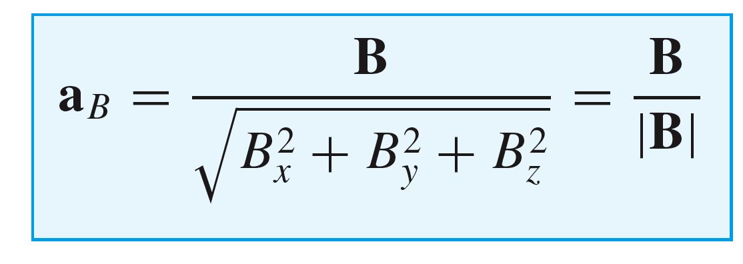
1: Vector Analysis 矢量分析
Summary-Vector expressions in rectangular coordinates
General Vector, B:
Magnitude of B:
Unit Vector in the
Direction of B:
14

Slide 16
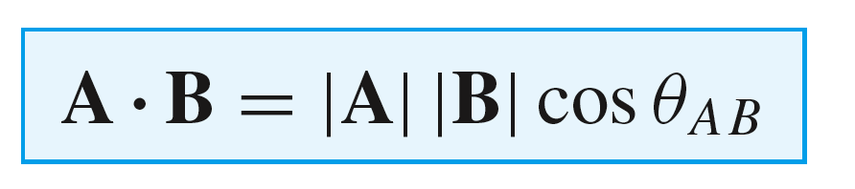

1: Vector Analysis 矢量分析
The Dot Product of Vectors矢量点乘
Given two vectors A and B, the dot product is defined as the product of the magnitude of A, the magnitude of B, and the cosine of the smaller angle between them,
Commutative Law交换律:
Note: The dot product of two vectors is a scalar.
15

Slide 17
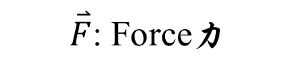

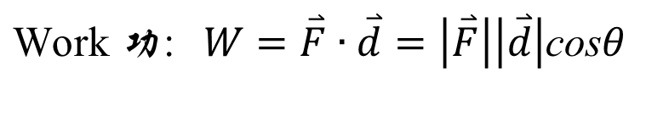
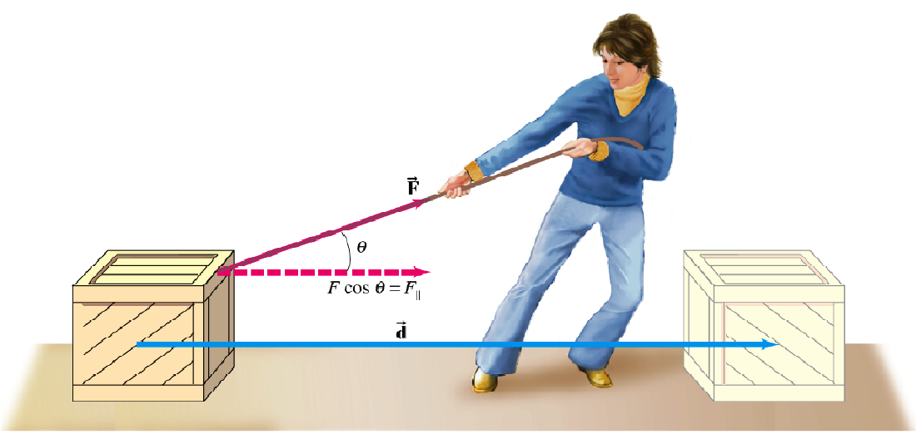
1: Vector Analysis 矢量分析
The Dot Product of Vectors矢量点乘
Example: How to calculate the work (功) applied on the wood box?
16

Slide 18
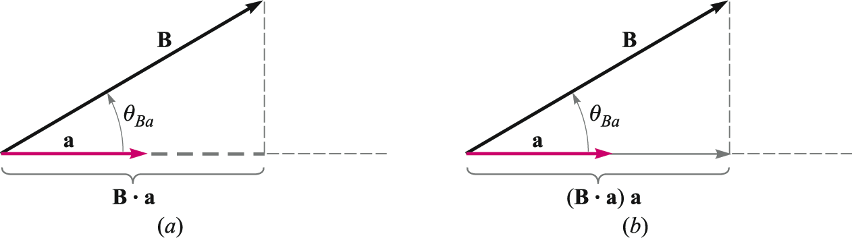
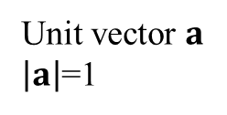
1: Vector Analysis 矢量分析
The Dot Product of Vectors矢量点乘
Vector Projections (矢量投影) Using the Dot Product
B • a gives the scalar component of B in the horizontal direction
(B • a) a gives the vector component
of B in the horizontal direction
17

Slide 19
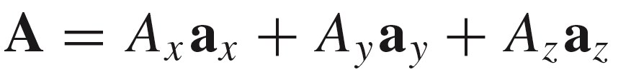


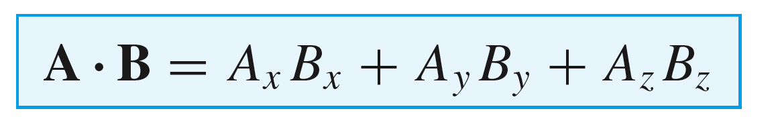
1: Vector Analysis 矢量分析
The Dot Product of Vectors矢量点乘
Operational Use of the Dot Product
Given
Here we use:
Finally we find
18

Slide 20
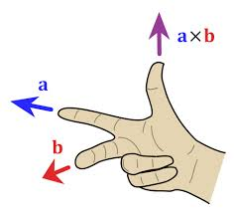
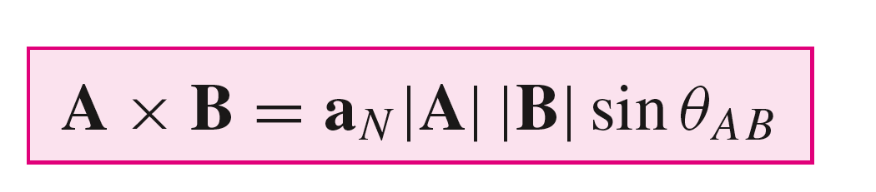
1: Vector Analysis 矢量分析
The Cross Product of Vectors矢量叉乘
The cross product A×B is a vector; the magnitude of A×B is equal to the product of the magnitudes of A, B, and the sine of the smaller angle between A and B; the direction of A×B is perpendicular to the plane containing A and B and the right-handed law.
19

Slide 21
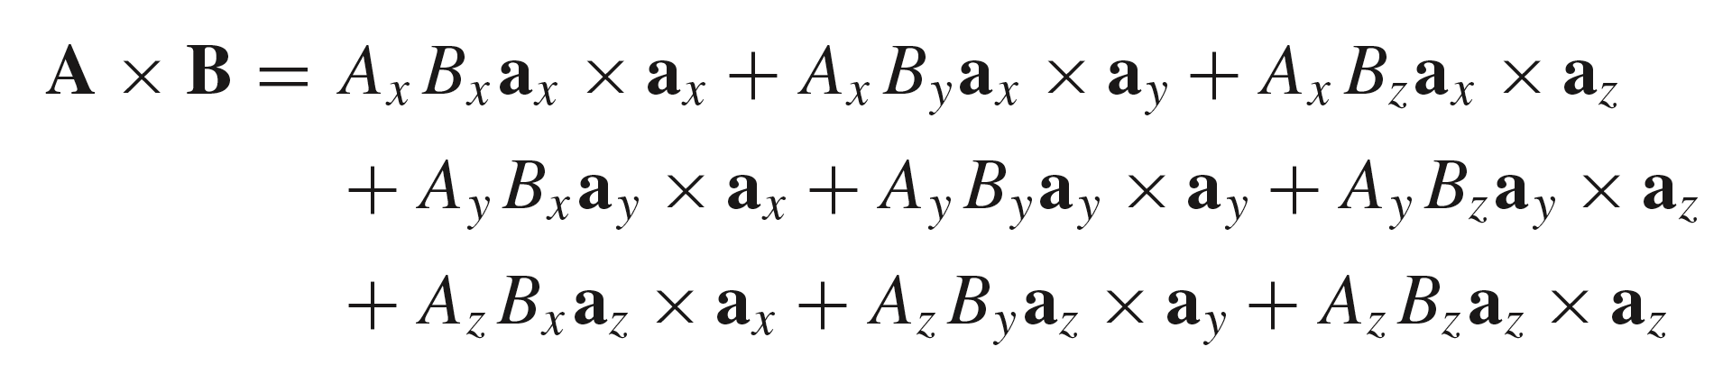









1: Vector Analysis 矢量分析
The Cross Product of Vectors矢量叉乘
Operational Use of the Cross Product
Given
20

Slide 22
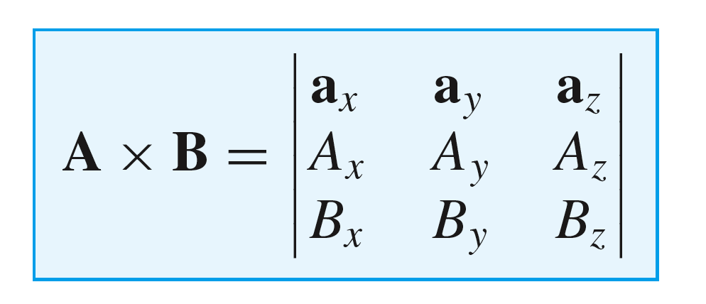
1: Vector Analysis 矢量分析
The Cross Product of Vectors矢量叉乘
Operational Use of the Cross Product
Given
Therefore:
Or…
A determinant in a more easily remembered form!
21

Slide 23
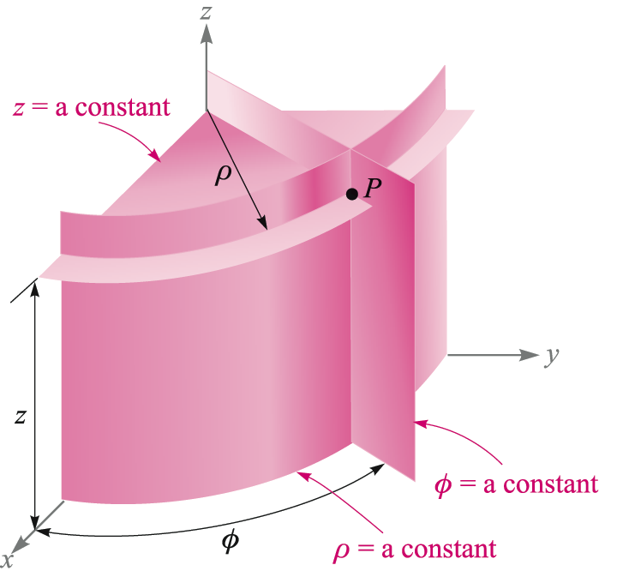
1: Vector Analysis 矢量分析
Circular Cylindrical Coordinates圆柱坐标系
Point P has coordinates specified by P(ρ,φ,z)
22

Slide 24
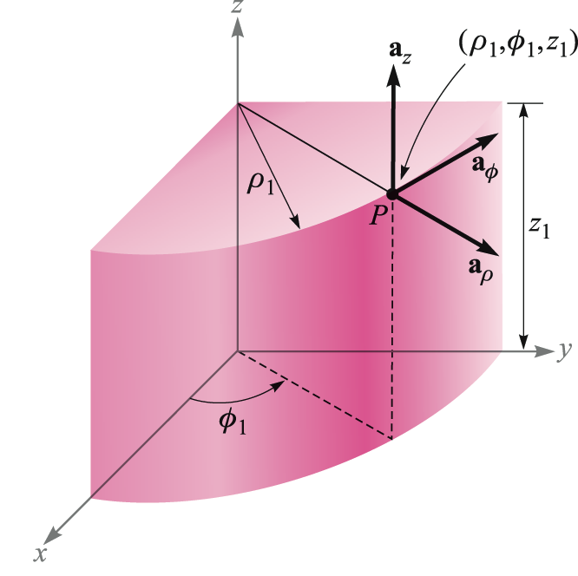
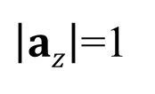
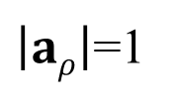
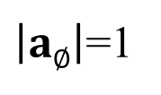
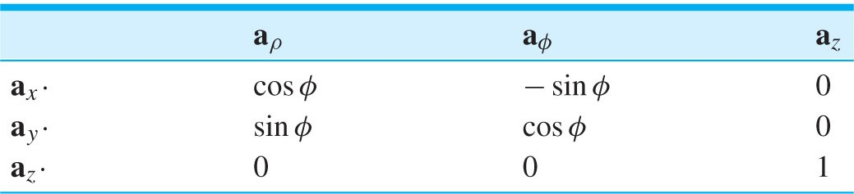
1: Vector Analysis 矢量分析
Circular Cylindrical Coordinates圆柱坐标系
Orthogonal Unit Vectors in Cylindrical Coordinates
23

Slide 25
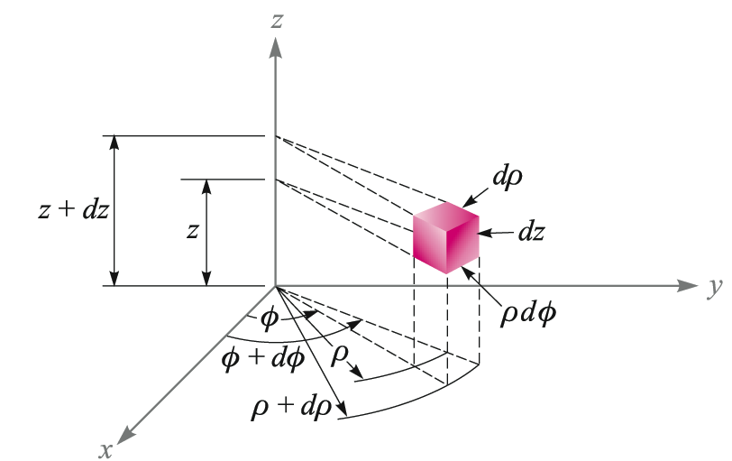
1: Vector Analysis 矢量分析
Circular Cylindrical Coordinates圆柱坐标系
Differential Volume in Cylindrical Coordinates
dV = ρ dρ dφ dz
24

Slide 26
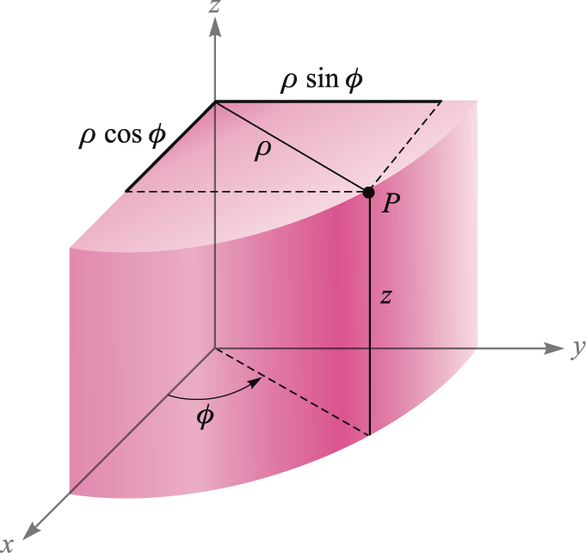
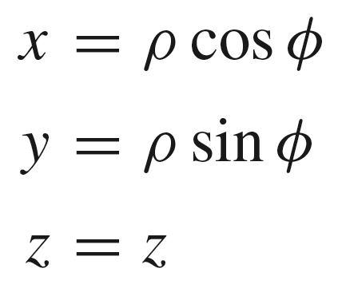
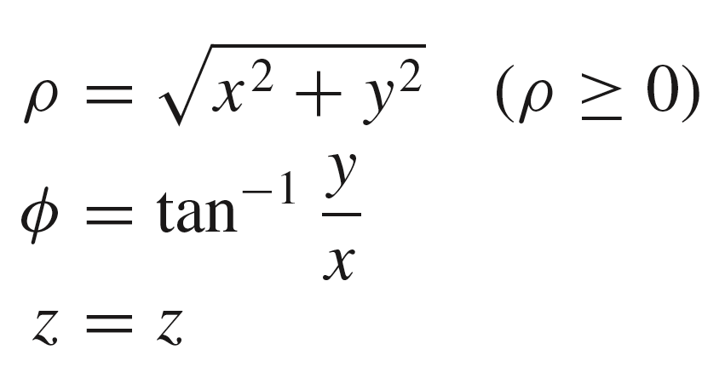
1: Vector Analysis 矢量分析
Circular Cylindrical Coordinates圆柱坐标系
Coordinate Transformations between Cylindrical Coordinates and Rectangular Coordinates 坐标变换:
P(ρ,φ,z)
P(x, y, z)
25

Slide 27
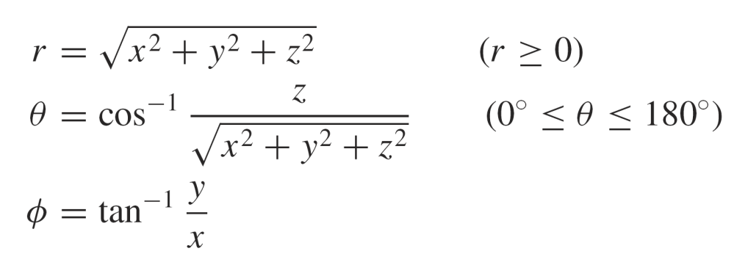
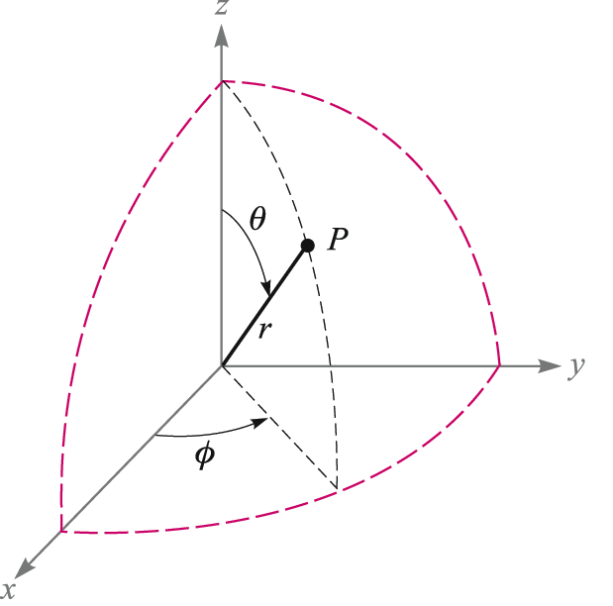
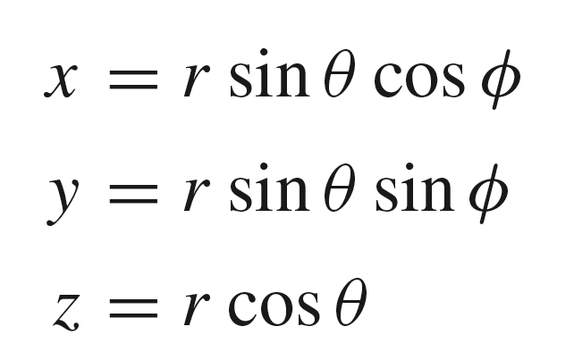
1: Vector Analysis 矢量分析
Spherical Coordinates 球坐标系
Point P has coordinates
Specified by P(r,θ,φ)
26

Slide 28





1: Vector Analysis 矢量分析
Spherical Coordinates 球坐标系
Orthogonal Unit Vectors in Spherical Coordinates
27

Slide 29

1: Vector Analysis 矢量分析
Spherical Coordinates 球坐标系
Differential Volume in Spherical Coordinates
dV = r²sinθ drdθ dφ
28

Slide 30

1: Vector Analysis 矢量分析
28

Slide 31

1: Vector Analysis 矢量分析
Coordinate Transformation
25

Slide 32

HW1
29

